Slide 1

SQL Capstone – Warby Parker Funnel Analysis
Lauren Mira
Learn SQL from Scratch
#cohort-nov-13-2018

Slide 2
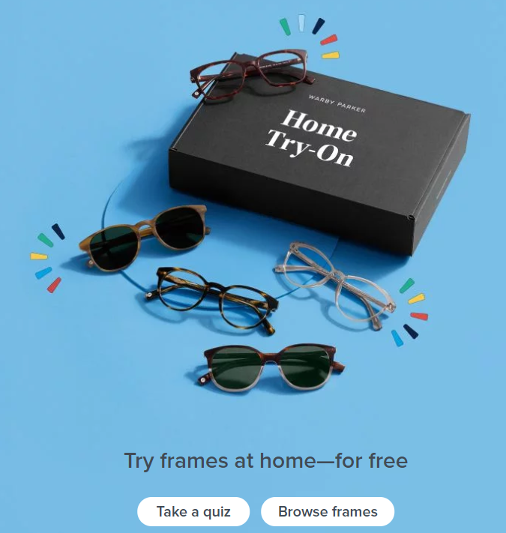
TABLE OF CONTENTS
Get Familiar with Warby Parker
What is the Quiz Funnel?
A/B testing with Home Try On Funnel
Purchase trends
https://www.warbyparker.com/

Slide 3
Get Familiar with Warby Parker

Slide 4
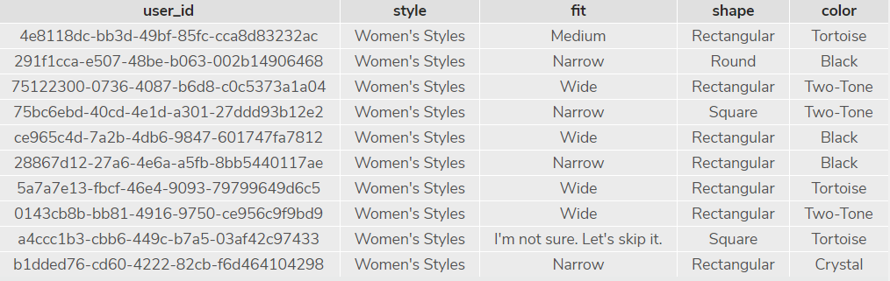
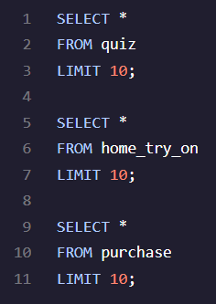
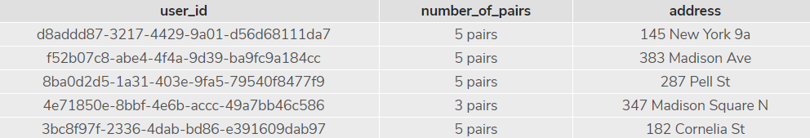
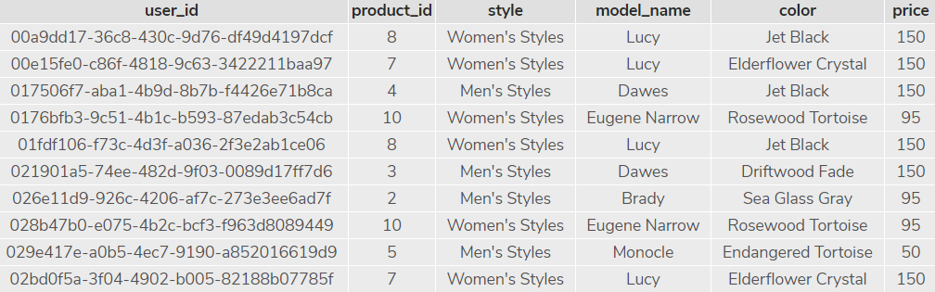
Getting Familiar with Warby Parker data tables
QUIZ
Warby Parker’s purchase funnel is
Complete Style Quiz
Home Try On
Purchase Pair of Glasses
Home_try_on
PURCHASE

Slide 5
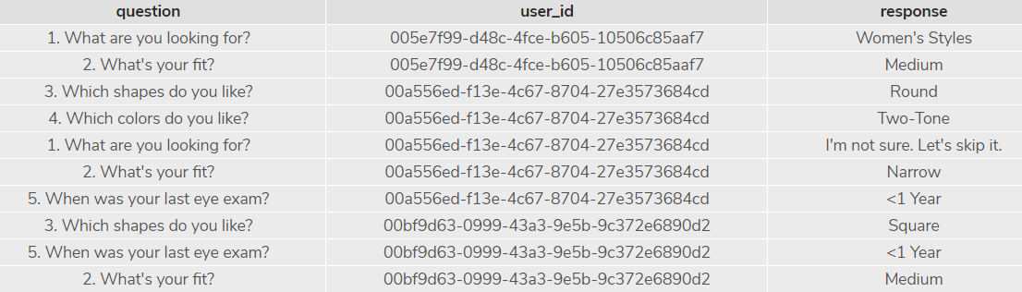

Users Must Take a Style Quiz!
User take a Style Quiz in order to help them find the perfect set of glasses - the quiz questions are below:
What are you looking for?
What’s your fit?
Which shapes do you like?
Which colors do you like?
When was your last eye exam?
These results are stored in the Survey table. See below for possible answers stored in the survey table.

Slide 6
Quiz Funnel Conversions
You often see people dropping off during any type of funnel, in this case, while taking the quiz and answering the 5 questions.
What is the number of responses for each question?
Which question(s) of the quiz have a lower completion rates?
What do you think is the reason?
Question 5 has the lowest completion rate. Perhaps this is the lowest completed question because 1) someone hasn’t had an eye exam or 2) folks can’t recall their last eye exam and don’t feel comfortable putting a random date/date range.
Chose to GROUP BY question in order to get an understanding of how many people answer each question.
Completion rate was calculated in Excel by simple division.
SELECT question, COUNT (user_id)
FROM survey
GROUP BY questions;
question | count (user_id) | Completion Rate
1. What are you looking for? | 500
2. What's your fit? | 475 | 95.0%
3. Which shapes do you like? | 380 | 80.0%
4. Which colors do you like? | 361 | 95.0%
5. When was your last eye exam? | 270 | 74.8%

Slide 7
The most common results of the style quiz (couldn’t figure this out ☹ )

Slide 8
A/B testing with Home Try On Funnel

Slide 9
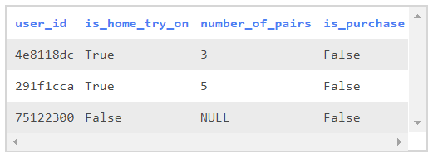
Does number of pairs tried on at home affect likelihood of purchasing?
Let's find out whether or not users who get more pairs to try on at home will be more likely to make a purchase by creating this new table:
This table will tell us
How many users tried on glasses at home (is_home_try_on)
How many pairs they tried on (number_of_pairs)
If they ended up purchasing a pair at the end (is_purchase) of this journey.

Slide 10
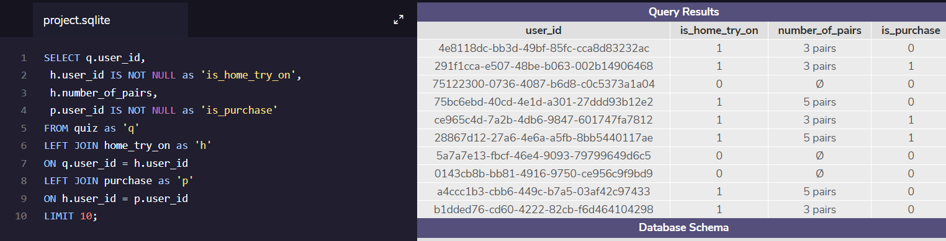
Does number of pairs tried on at home affect likelihood of purchasing? – Cont’d
First, I identified the following:
Now I will ‘Use a LEFT JOIN to combine the three tables’ and add in columns indicating if someone tried on glasses at home and if they purchased.
Can join quiz and home_try_on
User_id
Can join home_try_on and purchase on
User_id
Can join quiz and purchase on
User_id
Style
Color
SELECT q.user_id,
h.user_id IS NOT NULL as 'is_home_try_on',
h.number_of_pairs,
p.user_id IS NOT NULL as 'is_purchase'
FROM quiz as 'q'
LEFT JOIN home_try_on as 'h'
ON q.user_id = h.user_id
LEFT JOIN purchase as 'p'
ON h.user_id = p.user_id
LIMIT 10;

Slide 11
Does number of pairs tried on at home affect likelihood of purchasing? – Cont’d
WITH conversions AS
(SELECT DISTINCT (q.user_id),
h.user_id IS NOT NULL as 'is_home_try_on',
h.number_of_pairs,
p.user_id IS NOT NULL as 'is_purchase'
FROM quiz as 'q'
LEFT JOIN home_try_on as 'h'
ON q.user_id = h.user_id
LEFT JOIN purchase as 'p'
ON h.user_id = p.user_id
)
SELECT COUNT (*) as 'num_quiz_takers', SUM(is_home_try_on) as 'num_home_try_on',
1.0 * SUM (is_home_try_on) / COUNT (*) as 'home_try_on_pct',
SUM (is_purchase) as 'num_purchase',
1.0 * SUM (is_purchase) / SUM (is_home_try_on) as 'purchase_pct'
FROM conversions;
Based on the results and query from the previous slide, we can calculate overall conversion rates by aggregating across all rows.
num_quiz_takers | num_home_try_on | home_try_on_pct | num_purchase | purchase_pct
1000 | 750 | 0.75 | 495 | 0.66
Results show that…
Quiz takers → Home Try On = 75%
Home Try On → Purchase = 66%

Slide 12
Breakdown of previous slide’s query
WITH conversions AS
(SELECT DISTINCT (q.user_id),
h.user_id IS NOT NULL as 'is_home_try_on',
h.number_of_pairs,
p.user_id IS NOT NULL as 'is_purchase'
FROM quiz as 'q'
LEFT JOIN home_try_on as 'h'
ON q.user_id = h.user_id
LEFT JOIN purchase as 'p'
ON h.user_id = p.user_id
)
SELECT COUNT (*) as 'num_quiz_takers', SUM(is_home_try_on) as 'num_home_try_on',
1.0 * SUM (is_home_try_on) / COUNT (*) as 'home_try_on_pct',
SUM (is_purchase) as 'num_purchase',
1.0 * SUM (is_purchase) / SUM (is_home_try_on) as 'purchase_pct'
FROM conversions;
Creating a temporary table called “conversions” enables me to utilize the columns in that table to easily calculate the conversion rates for each step of the Warby Parker funnel.
SELECT COUNT (*) inidicates the total number of people that started the funnel.
The last few lines are utilizing columns in the temporary table “conversions” and performing division to get the rates.

Slide 13
Additionally, I wanted to see what the overall conversion rate was from start to finish.
WITH conversions AS
(SELECT DISTINCT (q.user_id),
h.user_id IS NOT NULL as 'is_home_try_on',
h.number_of_pairs,
p.user_id IS NOT NULL as 'is_purchase'
FROM quiz as 'q'
LEFT JOIN home_try_on as 'h'
ON q.user_id = h.user_id
LEFT JOIN purchase as 'p'
ON h.user_id = p.user_id
)
SELECT COUNT (*) as 'num_quiz_takers', SUM(is_home_try_on) as 'num_home_try_on',
1.0 * SUM (is_home_try_on) / COUNT (*) as 'home_try_on_pct',
SUM (is_purchase) as 'num_purchase',
1.0 * SUM (is_purchase) / SUM (is_home_try_on) as 'purchase_pct',
1.0 * SUM (is_purchase) / COUNT (*) as 'overall_purchase_pct'
FROM conversions;
I added the boxed line (to the right) in order to calculate how many people complete purchase from the starting point of taking the style quiz.
For this slide and the previous slide, it is important to remember to use ‘1.0 *’ so the resulting data is a float integer.
Overall conversion from start to finish = 49.5%

Slide 14
Purchase Trends

Slide 15
Purchase Rates for Diff. # of Glasses Tried
Warby Parker offers to try on 3 or 5 pairs of glasses at home. Users can also opt to not try on any at home.
Let’s look at what the purchase rate is for those that try on 3 pairs vs. 5 pairs vs. none.

Slide 16
Conversion Rate for 3 Pairs of Home Try On = 53%
WITH conversions AS
(SELECT DISTINCT (q.user_id),
h.user_id IS NOT NULL as 'is_home_try_on',
h.number_of_pairs,
p.user_id IS NOT NULL as 'is_purchase'
FROM quiz as 'q'
LEFT JOIN home_try_on as 'h'
ON q.user_id = h.user_id
LEFT JOIN purchase as 'p'
ON h.user_id = p.user_id
WHERE number_of_pairs LIKE ‘3 pairs'
)
SELECT COUNT (*) as 'num_quiz_takers', SUM(is_home_try_on) as 'num_home_try_on',
1.0 * SUM (is_home_try_on) / COUNT (*) as 'home_try_on_pct',
SUM (is_purchase) as 'num_purchase',
1.0 * SUM (is_purchase) / SUM (is_home_try_on) as 'purchase_pct',
1.0 * SUM (is_purchase) / COUNT (*) as 'overall_purchase_pct'
FROM conversions;
The WHERE clause enables us to search for results that only look at number of pairs tried on that = 3.

Slide 17
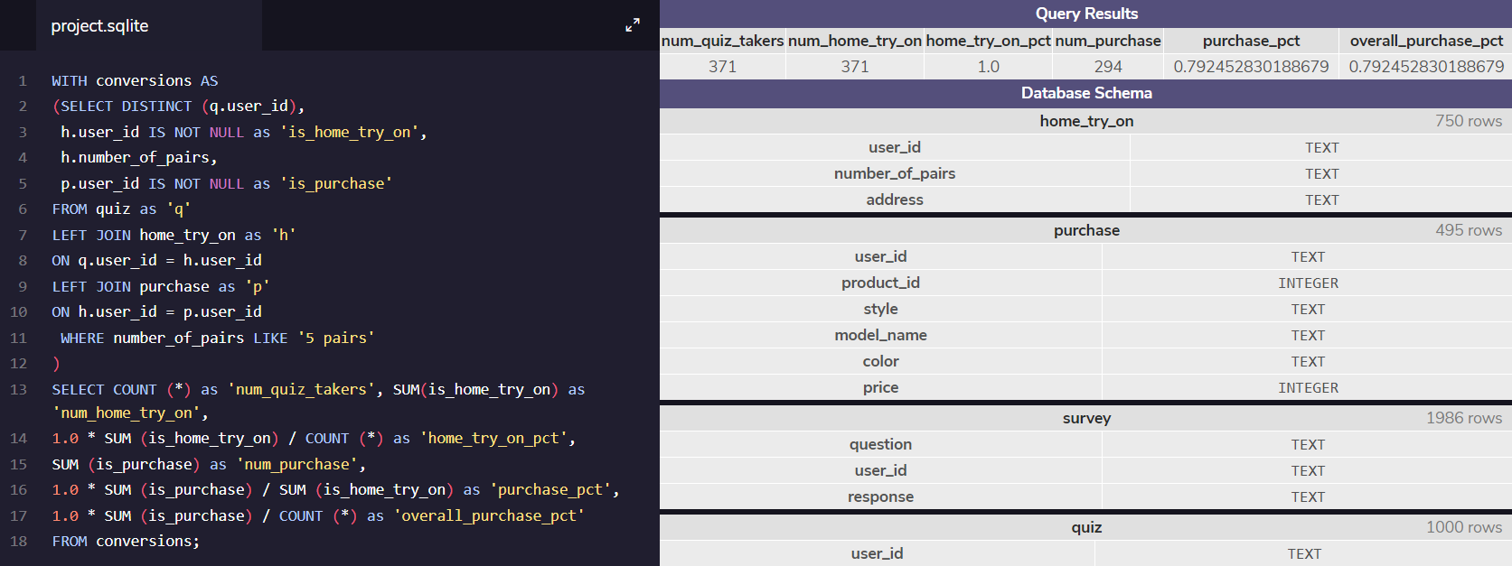
Conversion Rate for 5 Pairs of Home Try On = 79%
WITH conversions AS
(SELECT DISTINCT (q.user_id),
h.user_id IS NOT NULL as 'is_home_try_on',
h.number_of_pairs,
p.user_id IS NOT NULL as 'is_purchase'
FROM quiz as 'q'
LEFT JOIN home_try_on as 'h'
ON q.user_id = h.user_id
LEFT JOIN purchase as 'p'
ON h.user_id = p.user_id
WHERE number_of_pairs LIKE ‘5 pairs'
)
SELECT COUNT (*) as 'num_quiz_takers', SUM(is_home_try_on) as 'num_home_try_on',
1.0 * SUM (is_home_try_on) / COUNT (*) as 'home_try_on_pct',
SUM (is_purchase) as 'num_purchase',
1.0 * SUM (is_purchase) / SUM (is_home_try_on) as 'purchase_pct',
1.0 * SUM (is_purchase) / COUNT (*) as 'overall_purchase_pct'
FROM conversions;
The WHERE clause enables us to search for results that only look at number of pairs tried on that = 5.

Slide 18

Conversion Rate for 0 Pairs of Home Try On = 0%
WITH conversions AS
(SELECT DISTINCT (q.user_id),
h.user_id IS NOT NULL as 'is_home_try_on',
h.number_of_pairs,
p.user_id IS NOT NULL as 'is_purchase'
FROM quiz as 'q'
LEFT JOIN home_try_on as 'h'
ON q.user_id = h.user_id
LEFT JOIN purchase as 'p'
ON h.user_id = p.user_id
)
SELECT count (*),
SUM (is_home_try_on) as 'num_home_try_on',
SUM (is_purchase) as 'num_purchase'
FROM conversions
WHERE number_of_pairs IS NULL;
Users who try on 5 pairs versus 3 pairs have a higher conversion rate.
It may be interesting in the future for Warby Parker to test only giving customers the option to pick 5 glasses to try on.

Slide 19
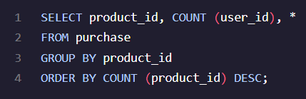
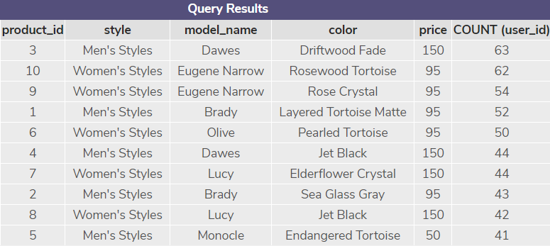
The most common types of purchase made
Per the right query, we can see that the Product ID 3 was the most purchased item at 63 users.
The following top 4 items though are priced at $95 rather than the top item that is priced at $150.
Perhaps Warby Parker should consider re-pricing items around the $95 range so they can see an increase in volume for the lower ranked items.

